Slide 1

Superuser Manual
Import New Stakeholders

Slide 2
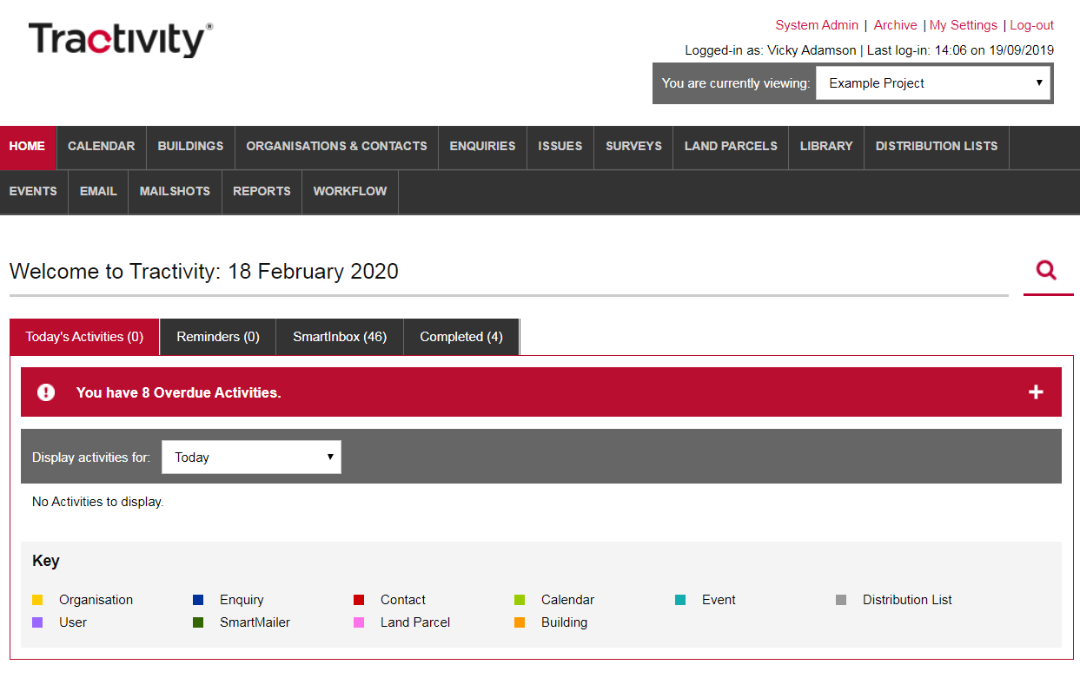
Login to Your Superuser Account
If you are an elected Superuser, you can access the System Admin area of Tractivity through your normal login, via a link shown in the top right-hand corner.
1

Slide 3
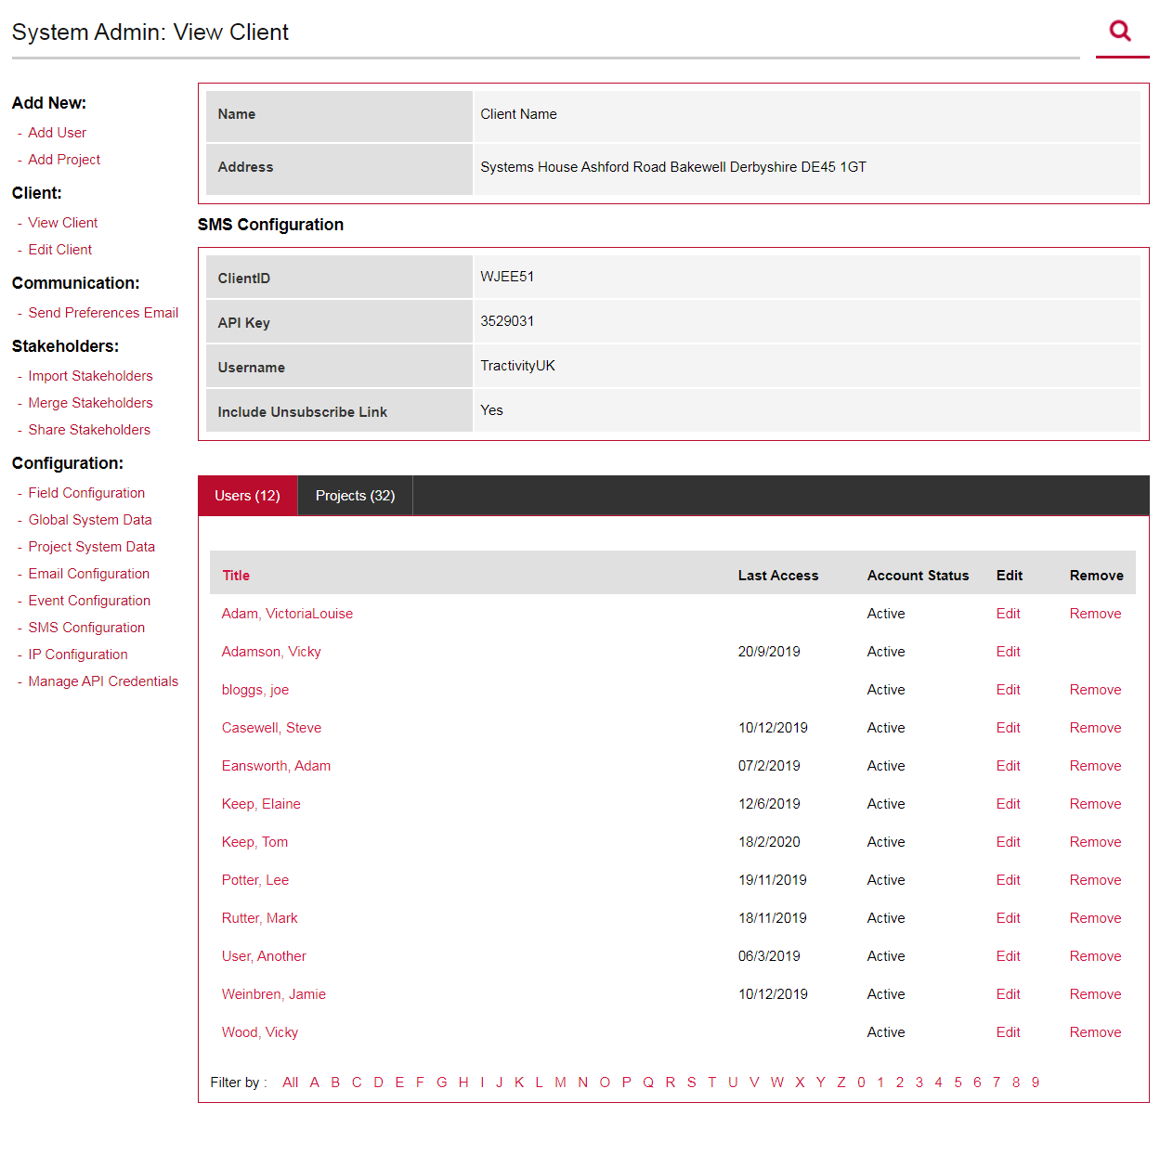
Stakeholders
Inside System Admin, on the left-hand menu under the section titled Stakeholders, you can:
Import Stakeholders
Merge Stakeholders
Share Stakeholder
1

Slide 4
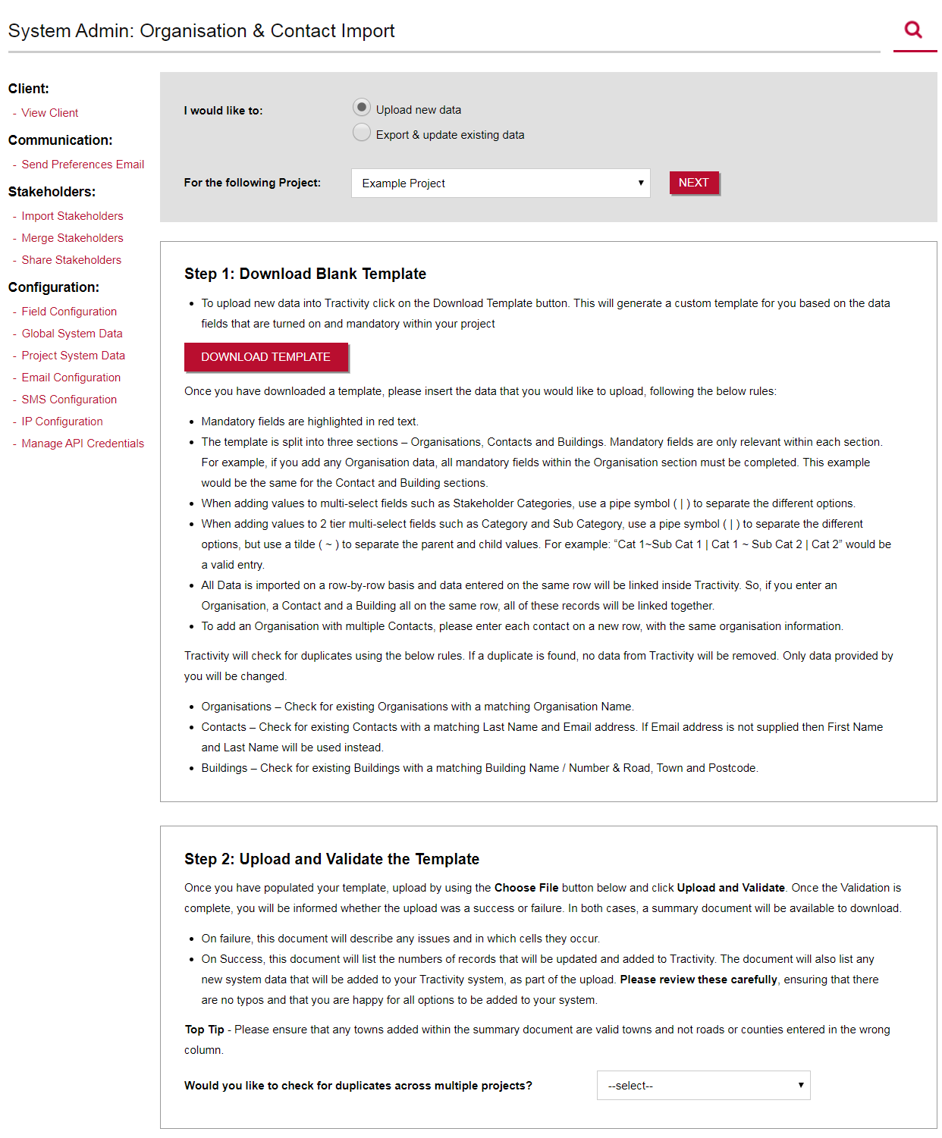
Import Stakeholders
Step 1
Click Import Stakeholders
Select to Upload New Data or Export & Update Existing Data (great for a data cleanse).
Select a project from the drop-down list and click NEXT.
Download Template generates a custom template based on the information you record inside your project. Every time you change the configuration of your system, the template will change.
Mandatory fields are highlighted in red text.
2
3
1
4

Slide 5
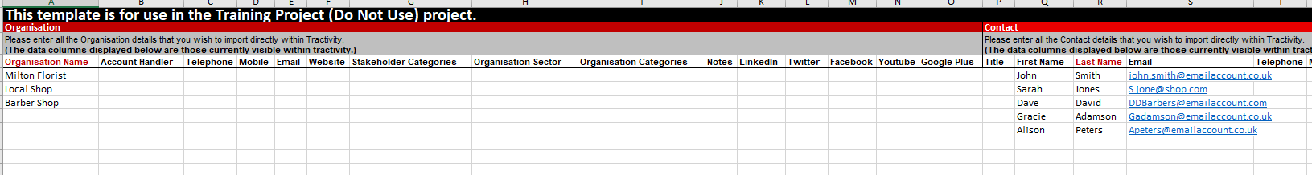
Import Stakeholders
Step 1 – Template Rules
Once you have downloaded a template, please insert the data that you would like to upload, following the below rules:
Notice that some column headers are highlighted with red text – this means the information is compulsory
The template is split into three sections – Organisations, Contacts and Buildings.
Mandatory fields are only relevant within each section. For example, if you add any Organisation data, all mandatory fields within the Organisation section must be completed. This example would be the same for the Contact and Building sections.
Please remember all Data is imported on a row-by-row basis and data entered on the same row will be linked inside Tractivity. So, if you enter an Organisation, a Contact and a Building all on the same row, all of these records will be linked together.
1
1
2
3

Slide 6
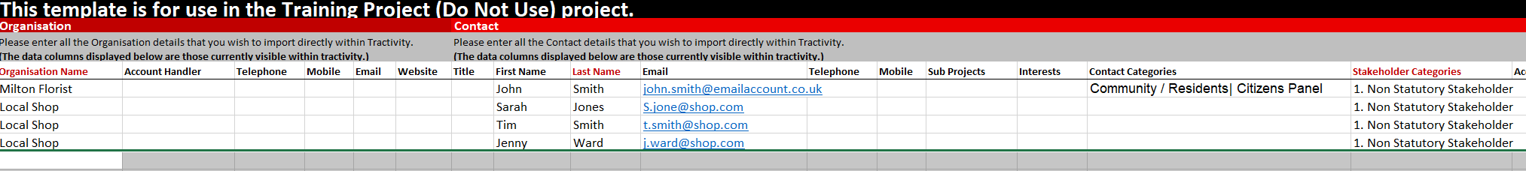
Import Stakeholders
Step 1- Template Rules
When adding values to 2 tier multi-select fields such as Category and Sub Category, use a pipe symbol ( | ) to separate the different options, but use a tilde ( ~ ) to separate the parent and child values. For example: “Cat 1~Sub Cat 1 | Cat 1 ~ Sub Cat 2 | Cat 2” would be a valid entry.
To add an Organisation with multiple Contacts, please enter each contact on a new row, with the same organisation information.
1
2

Slide 7
Import Stakeholders
Step 1- Template Rules
When uploading an Address please ensure you complete the Default Address Field with Yes Or No as this is mandatory.
1

Slide 8
Import Stakeholders
Step 1- Template Rules
Tractivity will check for duplicates using the below rules.
If a duplicate is found, no data from Tractivity will be removed. Only data provided by you will be changed.
Organisations – Check for existing Organisations with a matching Organisation Name.
Contacts – Check for existing Contacts with a matching Last Name and Email address. If Email address is not supplied then First Name and Last Name will be used instead.
Buildings – Check for existing Buildings with a matching Building Name / Number & Road, Town and Postcode.

Slide 9
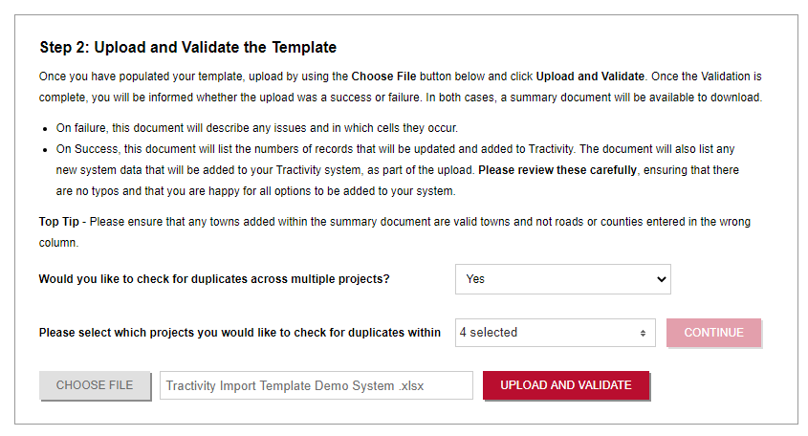
Import Stakeholders
Step 2- Upload and Validate your Template
Do you run multiple projects from Tractivity? If so, would you like to check duplications across all your projects?
If you select Yes, you can select which projects you would like to check for duplication
Choose File, Upload your template and Click UPLOAD AND VALIDATE
1
2
3

Slide 10
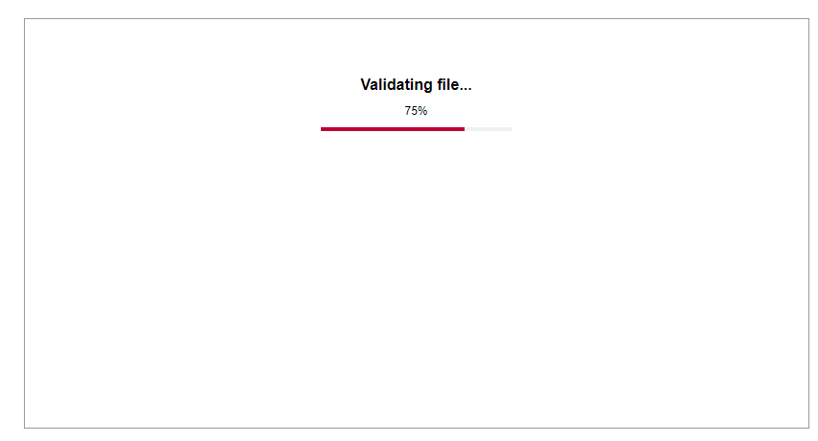
Import Stakeholders
Step 2- Upload and Validate your Template
Validating File indicates the percentage of validation completed.
1

Slide 11
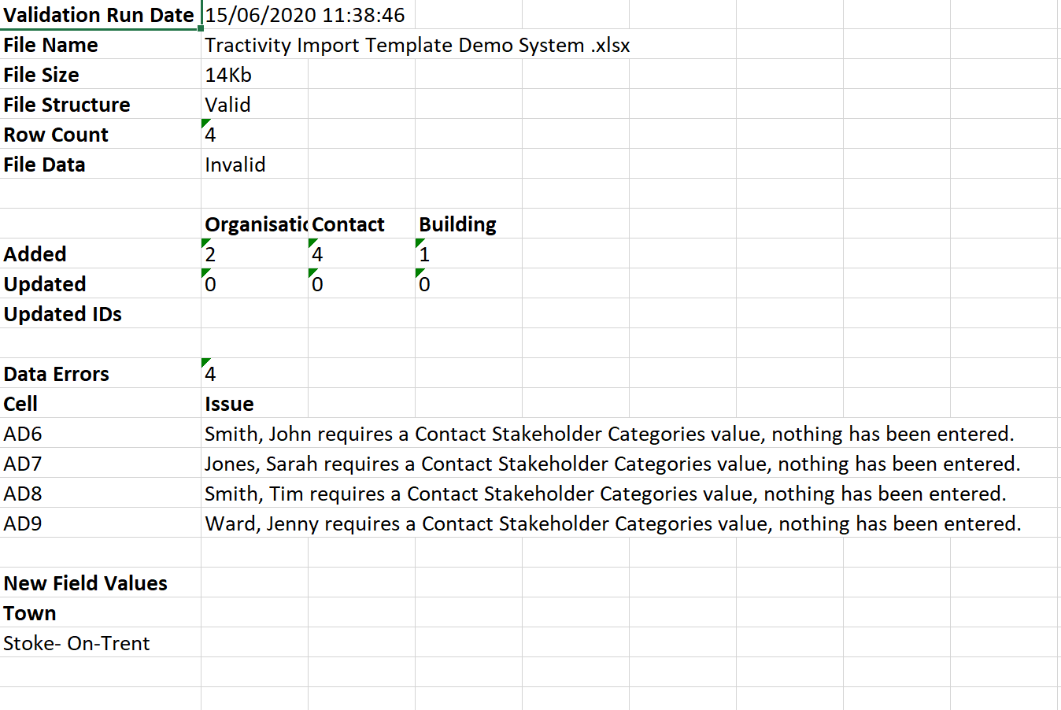
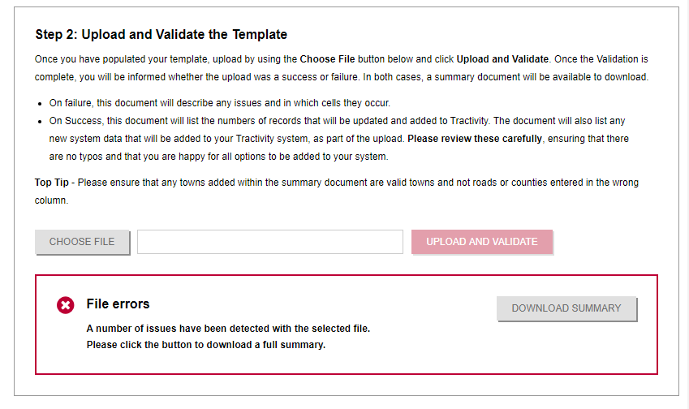
Import Stakeholders
Step 2- Upload and Validate your Template
File Errors – indicates issues with your data.
Click, DOWNLOAD SUMMARY
View a full summary of all issues
Amend your Template and re-upload and Validate
.
2
1
1

Slide 12
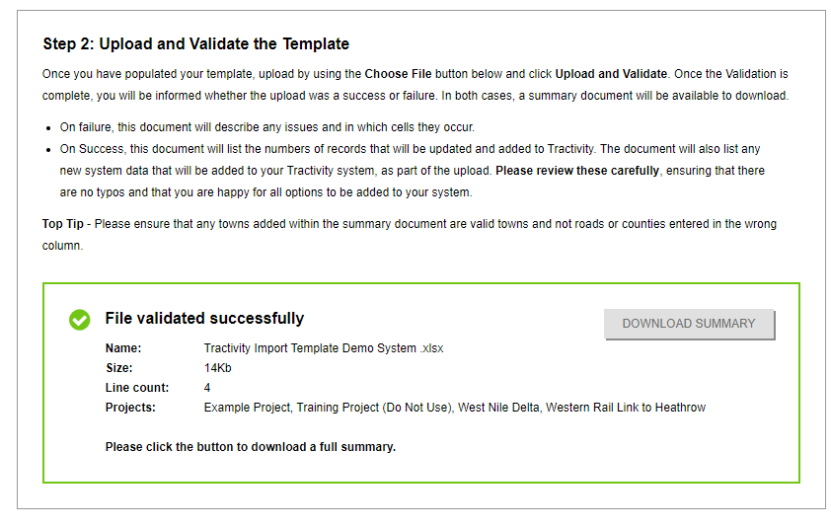
Import Stakeholders
Step 2- Upload and Validate your Template
File Validated Successful – means your data has been validated with no issues found.
It’s still very important to click DONWLOAND SUMMARY. It will provide an overview of your new upload, including the amount of new records, updated records and list any new drop-down list options.
1
1

Slide 13
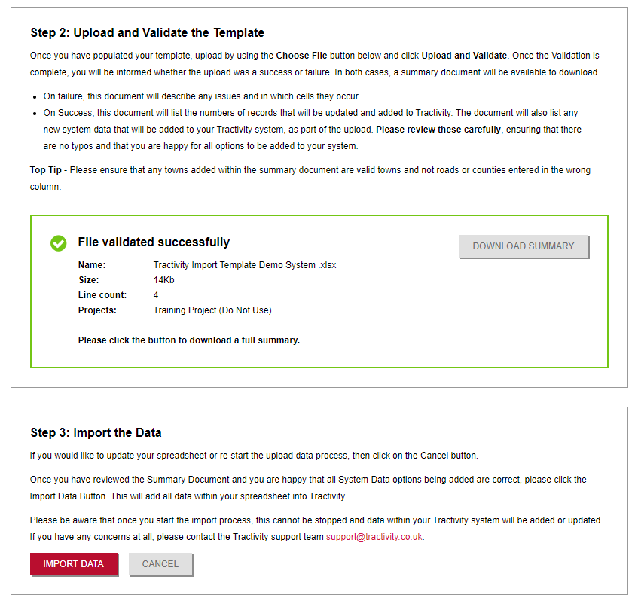
Import Stakeholders
Step 3- Import the Data
Once File Validates is successful & you have downloaded and reviewed the DOWNLOAD SUMMARY
Click Import Data
Importing Data cannot be reversed, be sure to check your Download Summary before you Import.
You can continue to use Tractivity as normal while the Import is completed
1
2

Slide 14
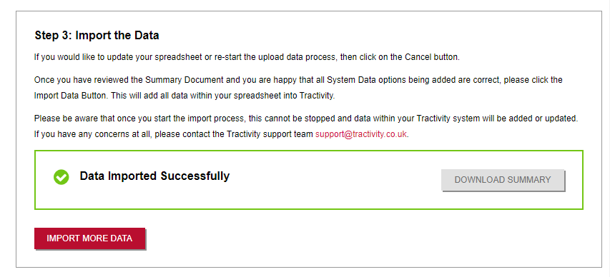
Import Stakeholders
Step 3- Import the Data
Data Imported Successful advises that the import is complete. Download a Summary and save to your desktop (for your reference).
Remember to click, IMPORT MORE DATA at the end, to show any other admin user that the upload is now complete.
1
2

Slide 15

Vicky Adamson
Client Relationship Manager
Systems House, Deepdale Business Park,
Bakewell, Derbyshire, DE45 1GT
www.tractivity.co.uk

