Slide 1



Slide 2
Adding Stakeholders, Enquiries and Issues to Your System
Add Contact Add Enquiry Add Activitie Add Issues

Slide 3
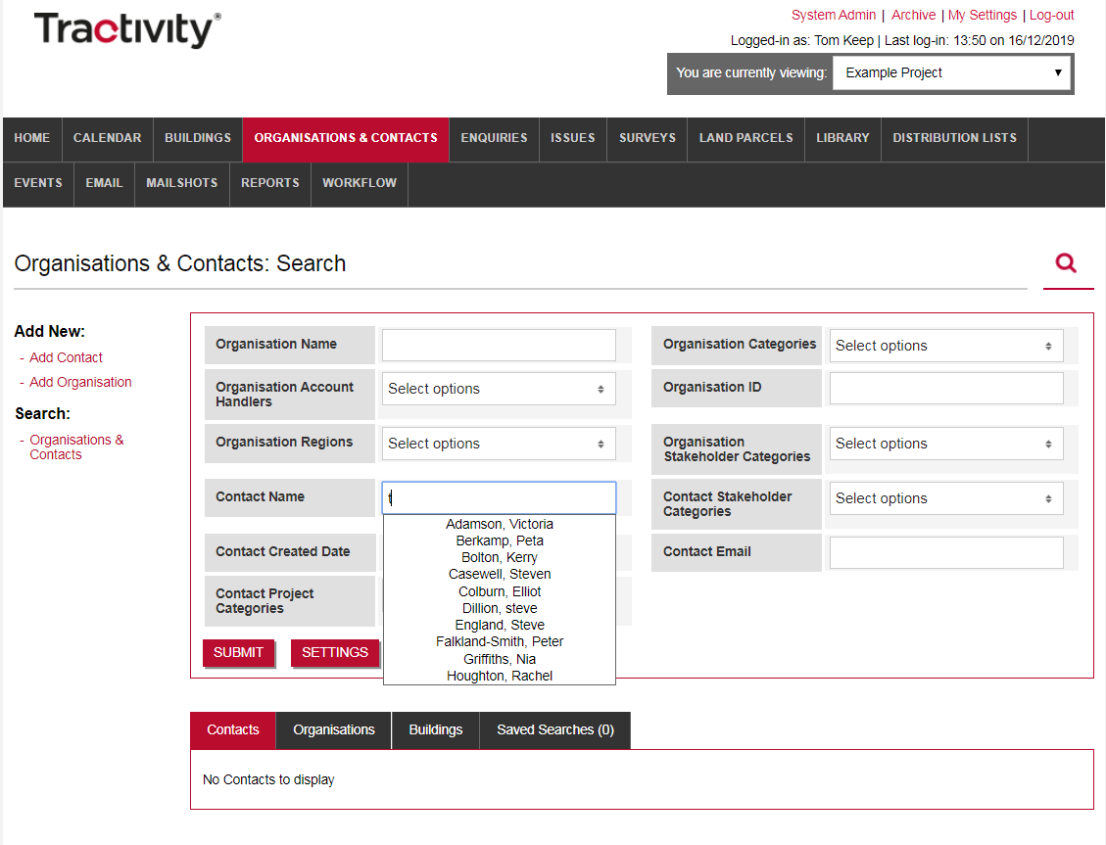
Always Search before adding New data
Use keywords to conduct detailed searches before adding new Organisations & Contact data to Tractivity.
Using the Search boxes, Organisation Name & Contact Name, as you type all exact matches will appear beneath.
Contact Search, use a contacts surname only. Don’t search for a full name, as the contact will not appear.
To see Everything inside your Tractivity System press SUBMIT. All contact’s, organisation’s and building’s.
1
2
3

Slide 4
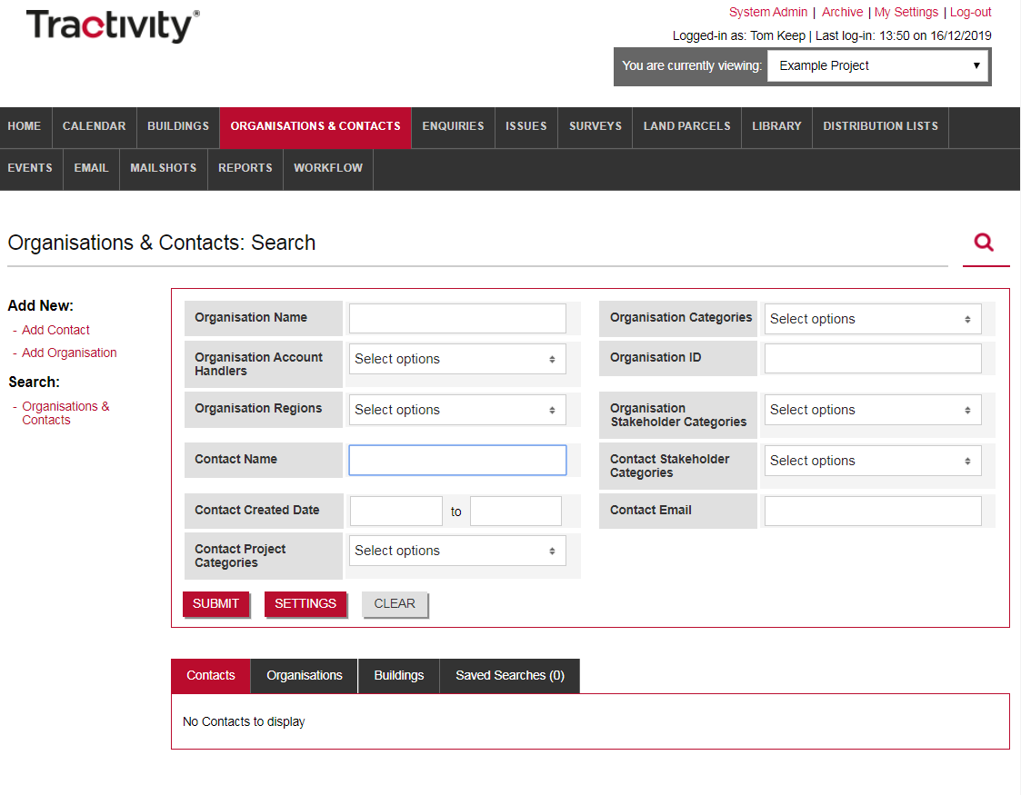
Add Organisation or Contact?
Add a Contact & Organisation to Tractivity or just a Contact:
Add Organisation or Add Contact, or just a contact – the choice is yours.
1

Slide 5
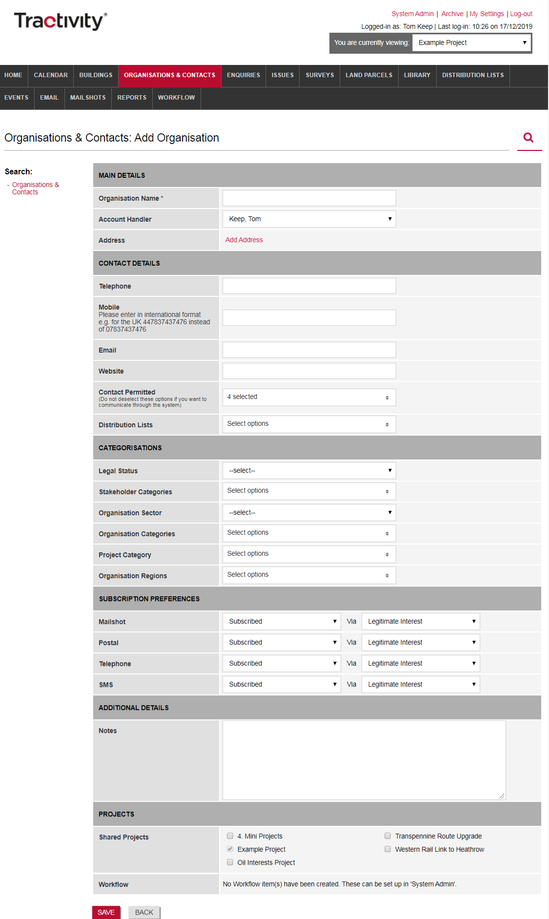
Add Organisation
1
From the Organisation & Contacts Module, on the left-hand menu select Add Organisation.
Organisation Screen is broken-down into six sections.
Main Details
Contact Details
Categorisations
Subscription Preferences
Additional Details
Projects
Tractivity is changeable, each client has full control of their system, including selecting the information you record, defining mandatory fields and drop-down lists.
Please note, that any information which has an * asterisk is mandatory and will require completing.
2
3
4
5
6

Slide 6
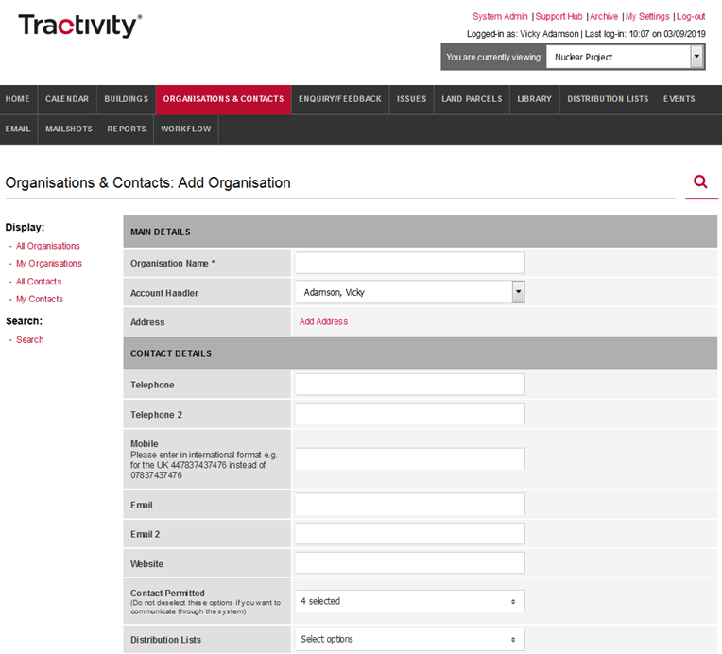
Main Details
Inside Main Details it only requires three bits of information:
Organisation Name – Add your organisation name here.
Account Handler – this will default to the logged in user. This can be amended to another member of your team, should you wish.
Add Address - using the postcode lookup tool and enter your postcode and all known addresses will be displayed.
1
2
3

Slide 7

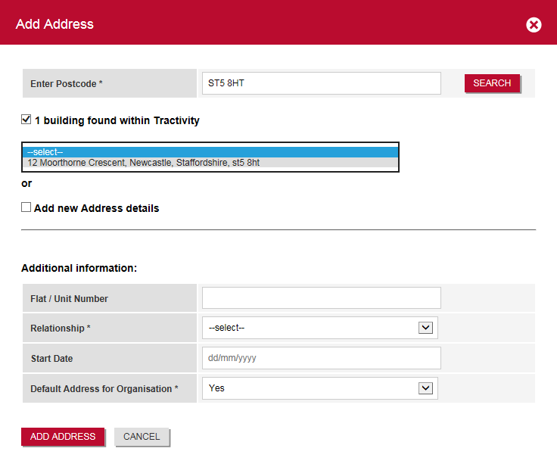
Add Organisation Address
Each address added to Tractivity, is recorded as a building. View all recorded Addresses via the Building Module on the black navigation bar.
Enter a Postcode & Search
Please note the system will first search for any matching addresses currently saved inside Tractivity. If no matching Building’s are found, select Add new address details here.
1
2
3
4

Slide 8
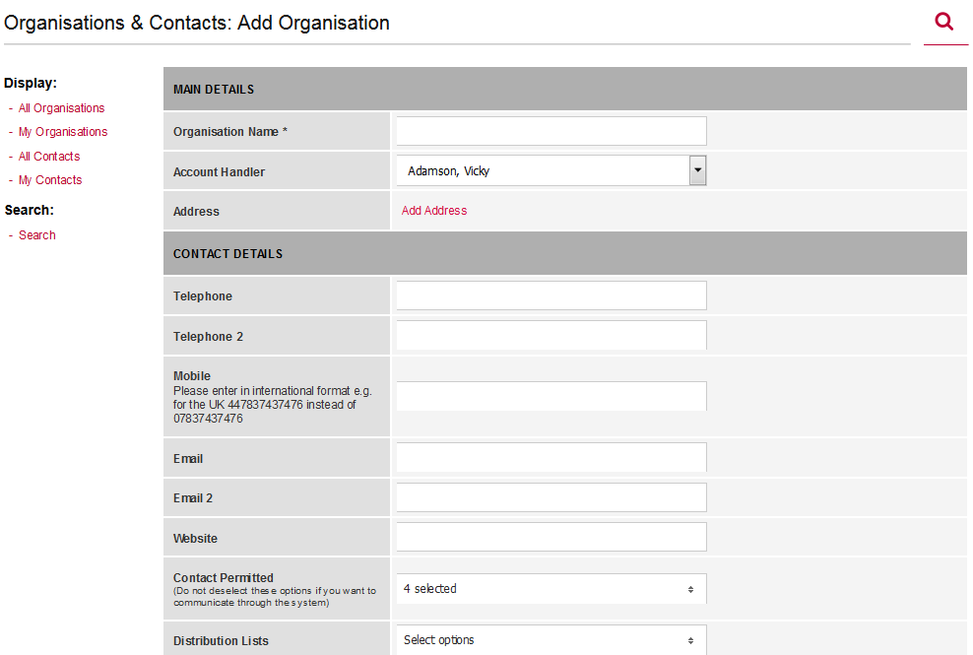
Contact Details
Record all your organisations details:
Email - If you have the option to record more than one email address, its good to note that only the email address added to Email, will be used when sending any mailshots.
Contact Permitted stops you from sending single communications on a one-to-one basis or attach a contact to any distribution lists.
1
2

Slide 9
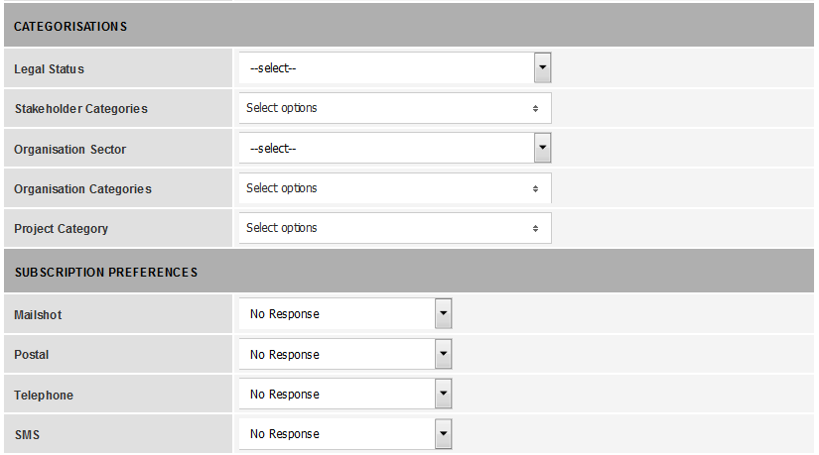
Categorisations
Categorise your Stakeholders, using the CATEGORISATIONS section.
You will notice some drop-down lists have a checkbox option, meaning you can select one, many, or all answers OR alternatively a drop-down list were only one option can be selected.
1

Slide 10
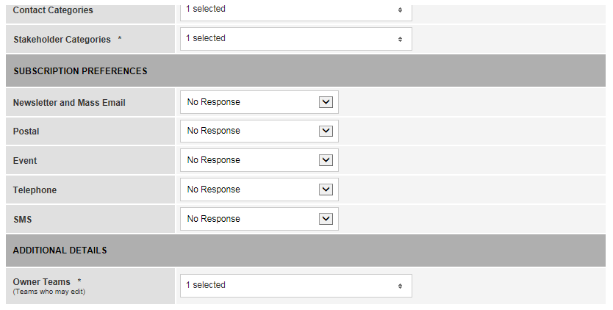
GDPR Subscription Preferences
Subscription Preferences, this this part of the system allows you to update, record and track marketing preferences. Amending marketing preferences, creates an auditable trail, including how the consent was obtained and the date. You can update this information in three ways;
Manually via this screen.
Clients who're stakeholder have a legitim interest make this part of this system automated – to arrange this change; please speak with your superuser.
Once you have added your Organisation, on the next screen, you will have an option to send an email to your Organisation to obtain consent.
1

Slide 11
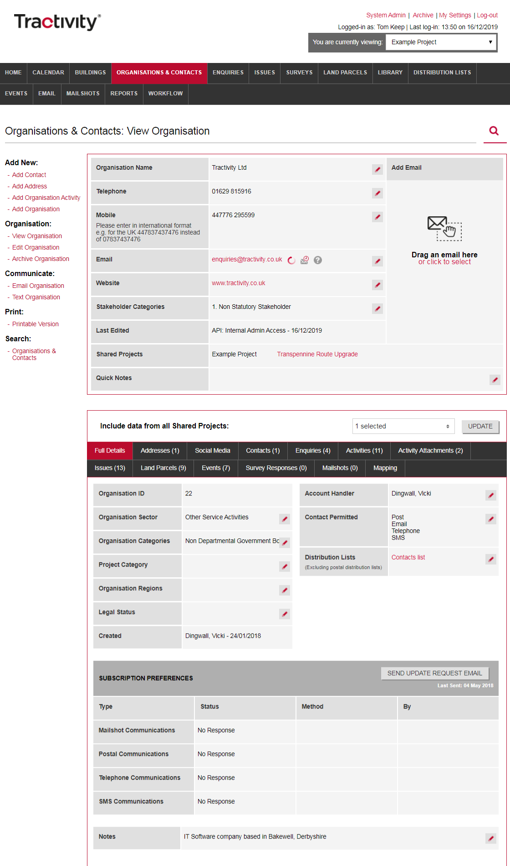
View Organisation Screen
1
Once an organisation has been added to Tractivity, you will be taken to the View Organisation.
View and Edit the information you have added, using the quick edit button.
Half-way navigation bar, will start to build and hold any information you add that relates to this Organisation, including contacts, activities & issues.
Send Update Request Email – if you have a valid email and email contact permitted selected. Selecting this, will send an automated email to your organisation asking them for GDPR consent.
2
3

Slide 12
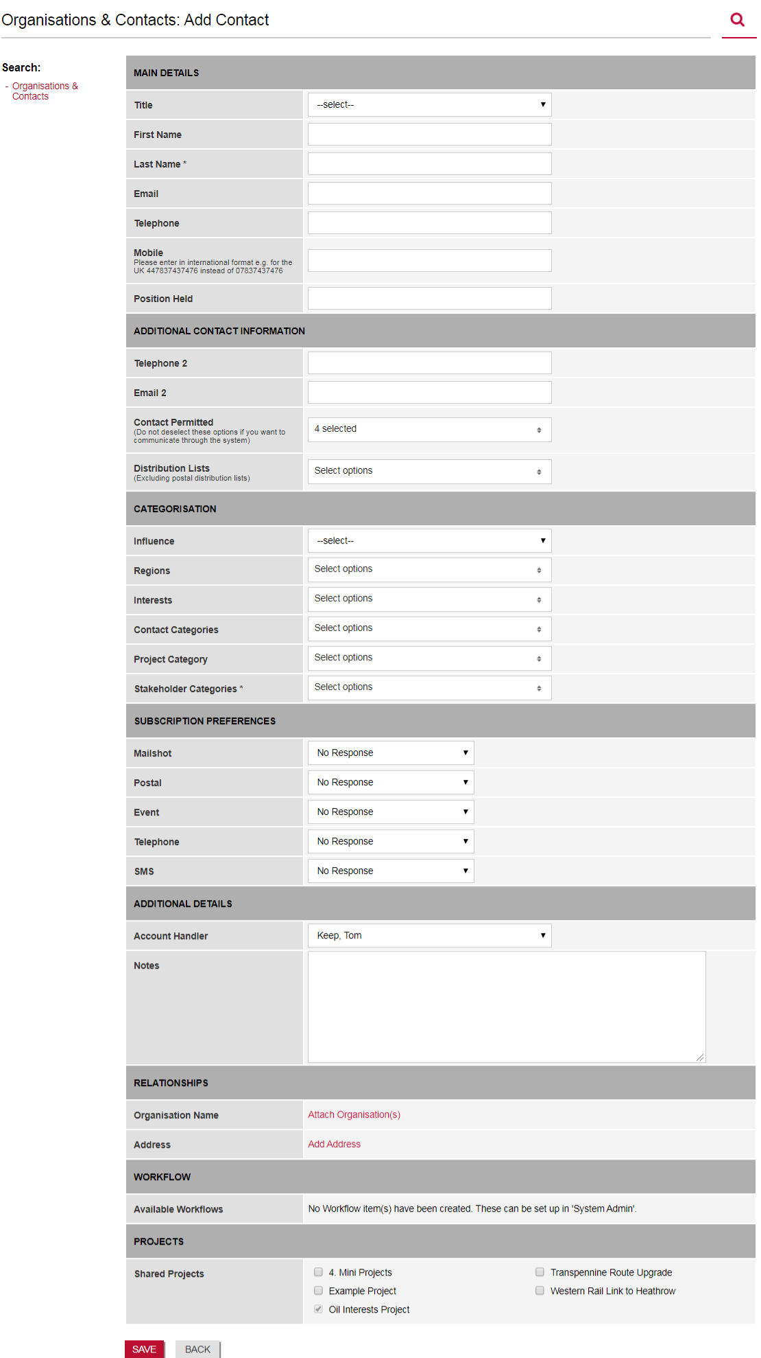
1
Add Contact
From the Organisation & Contacts Module, on the left-hand menu select ‘Add Contact’.
Same as the Organisation Screen the Contact Screen is broken-down into sections, these are;
Main Details
Additional Contact Information
Categorisation
Subscription Preferences
Additional Details
Relationships
Workflow
Projects
Tractivity is changeable and your organisation has full control of your system, including selecting the information you record, defining mandatory fields, to adding and amending the drop-down lists.
Please note - that any information which has an * asterisk is mandatory and will require completing.
2
3
4
5
6
7
8

Slide 13
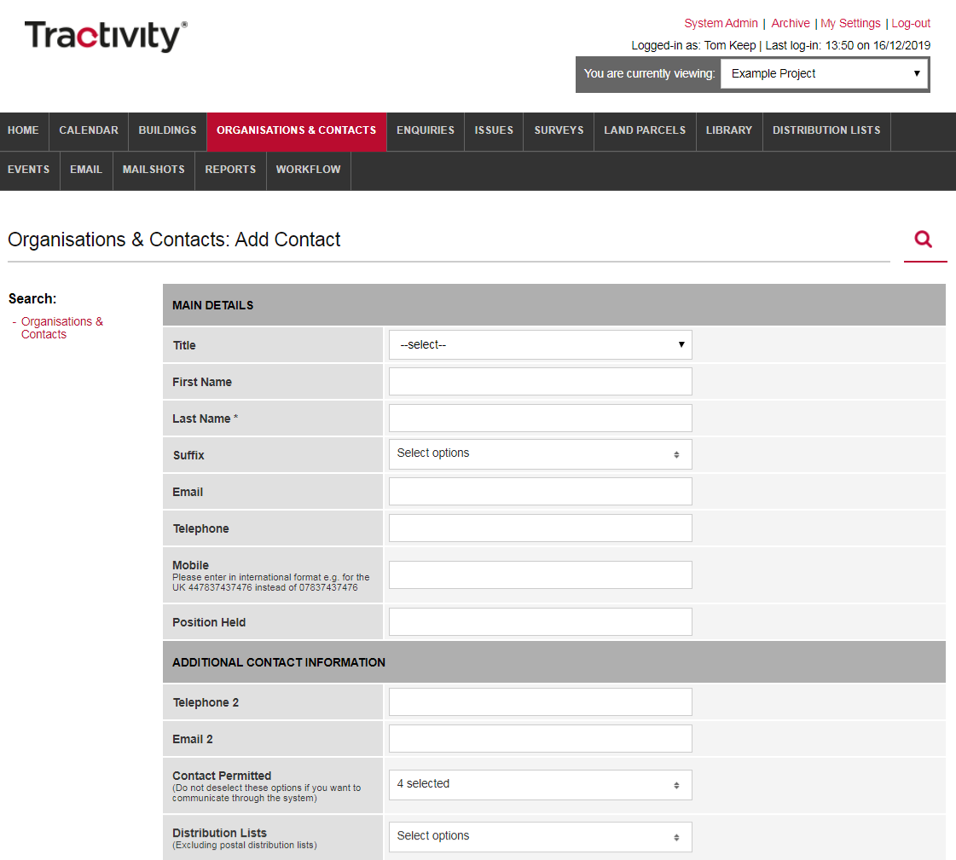
Main Details & Additional
Contact Information
Add as much information as you can, all the details added here should be related to your contact.
Email address, its good to note that only the email address added here, will be used when sending a mailshot.
Email 2 – is used more for your reference and could be used when sending plain text emails.
Contact Permitted stops you from sending single communications on a one-to-one basis or attach a contact to any distribution lists.
Please note - that any information which has an * asterisk is mandatory and will require completing.
1
2
3

Slide 14
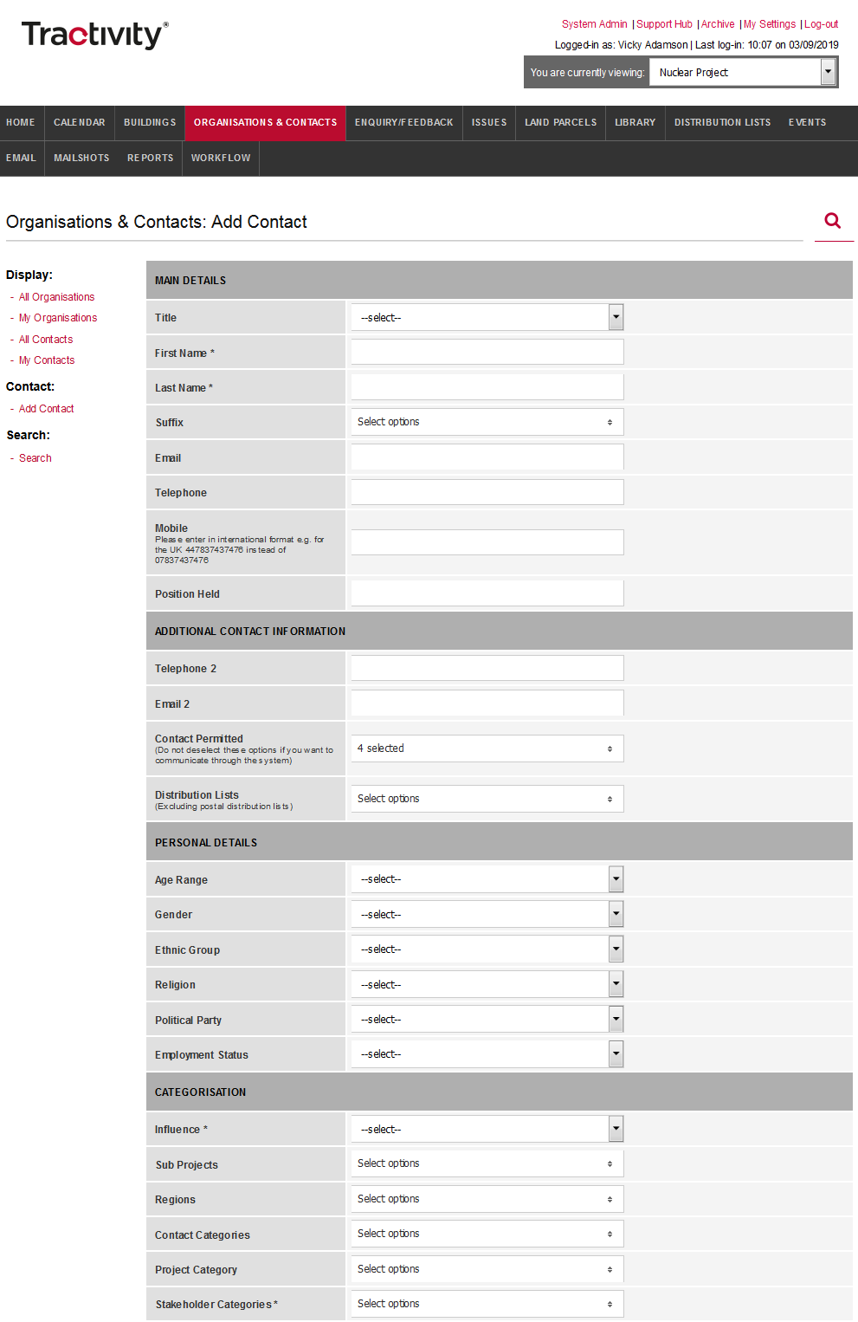

Personal Details &
Categorisations
Personal Details & Categorisation, allows you to record information about your stakeholder, including, Age, Gender, Influence.
Remember you can change the information you record, drop-down menus and the information that is mandatory.
1

Slide 15
Subscription Preferences
Subscription Preferences, this this part of the system allows you to update, record and track marketing preferences for each of your stakeholders.
You can update this information in three ways;
Manually Update
Gain their Subscription Preferences by sending an email . This can be done from the View Contact Screen.
1

Slide 16
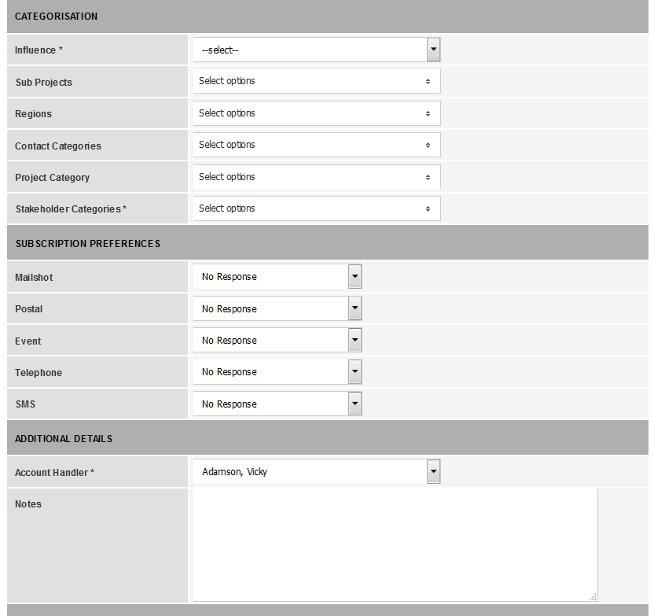
Additional Details
Within this section you can record;
Account Handler - this will default to the logged in user. This can be amended to another member of your team, should you wish.
Notes – any additional information/notes you wish to record against your contact for your information or other users.
1
2

Slide 17
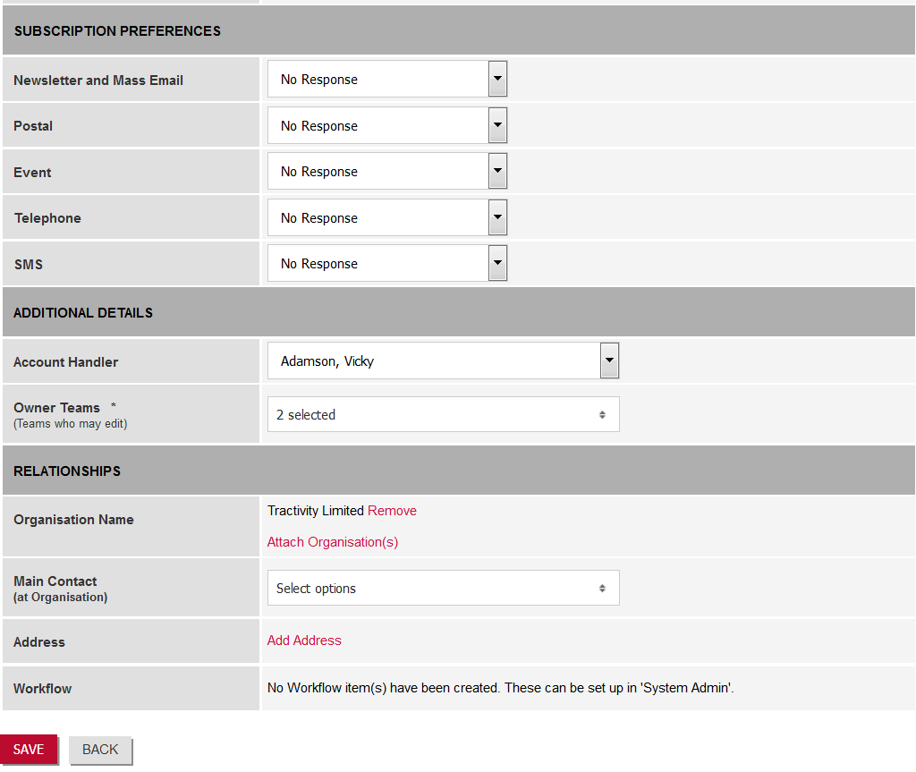
Relationships
Organisation Name attach one or many organisations against a contact.
Main Contact – is your contact the main contact at the organisation?
Add Address use the postcode lookup tool by adding your postcode and select from a list of known addresses.
.
1
2
Top Tip:
Always add a Contact address, were possible.
3

Slide 18
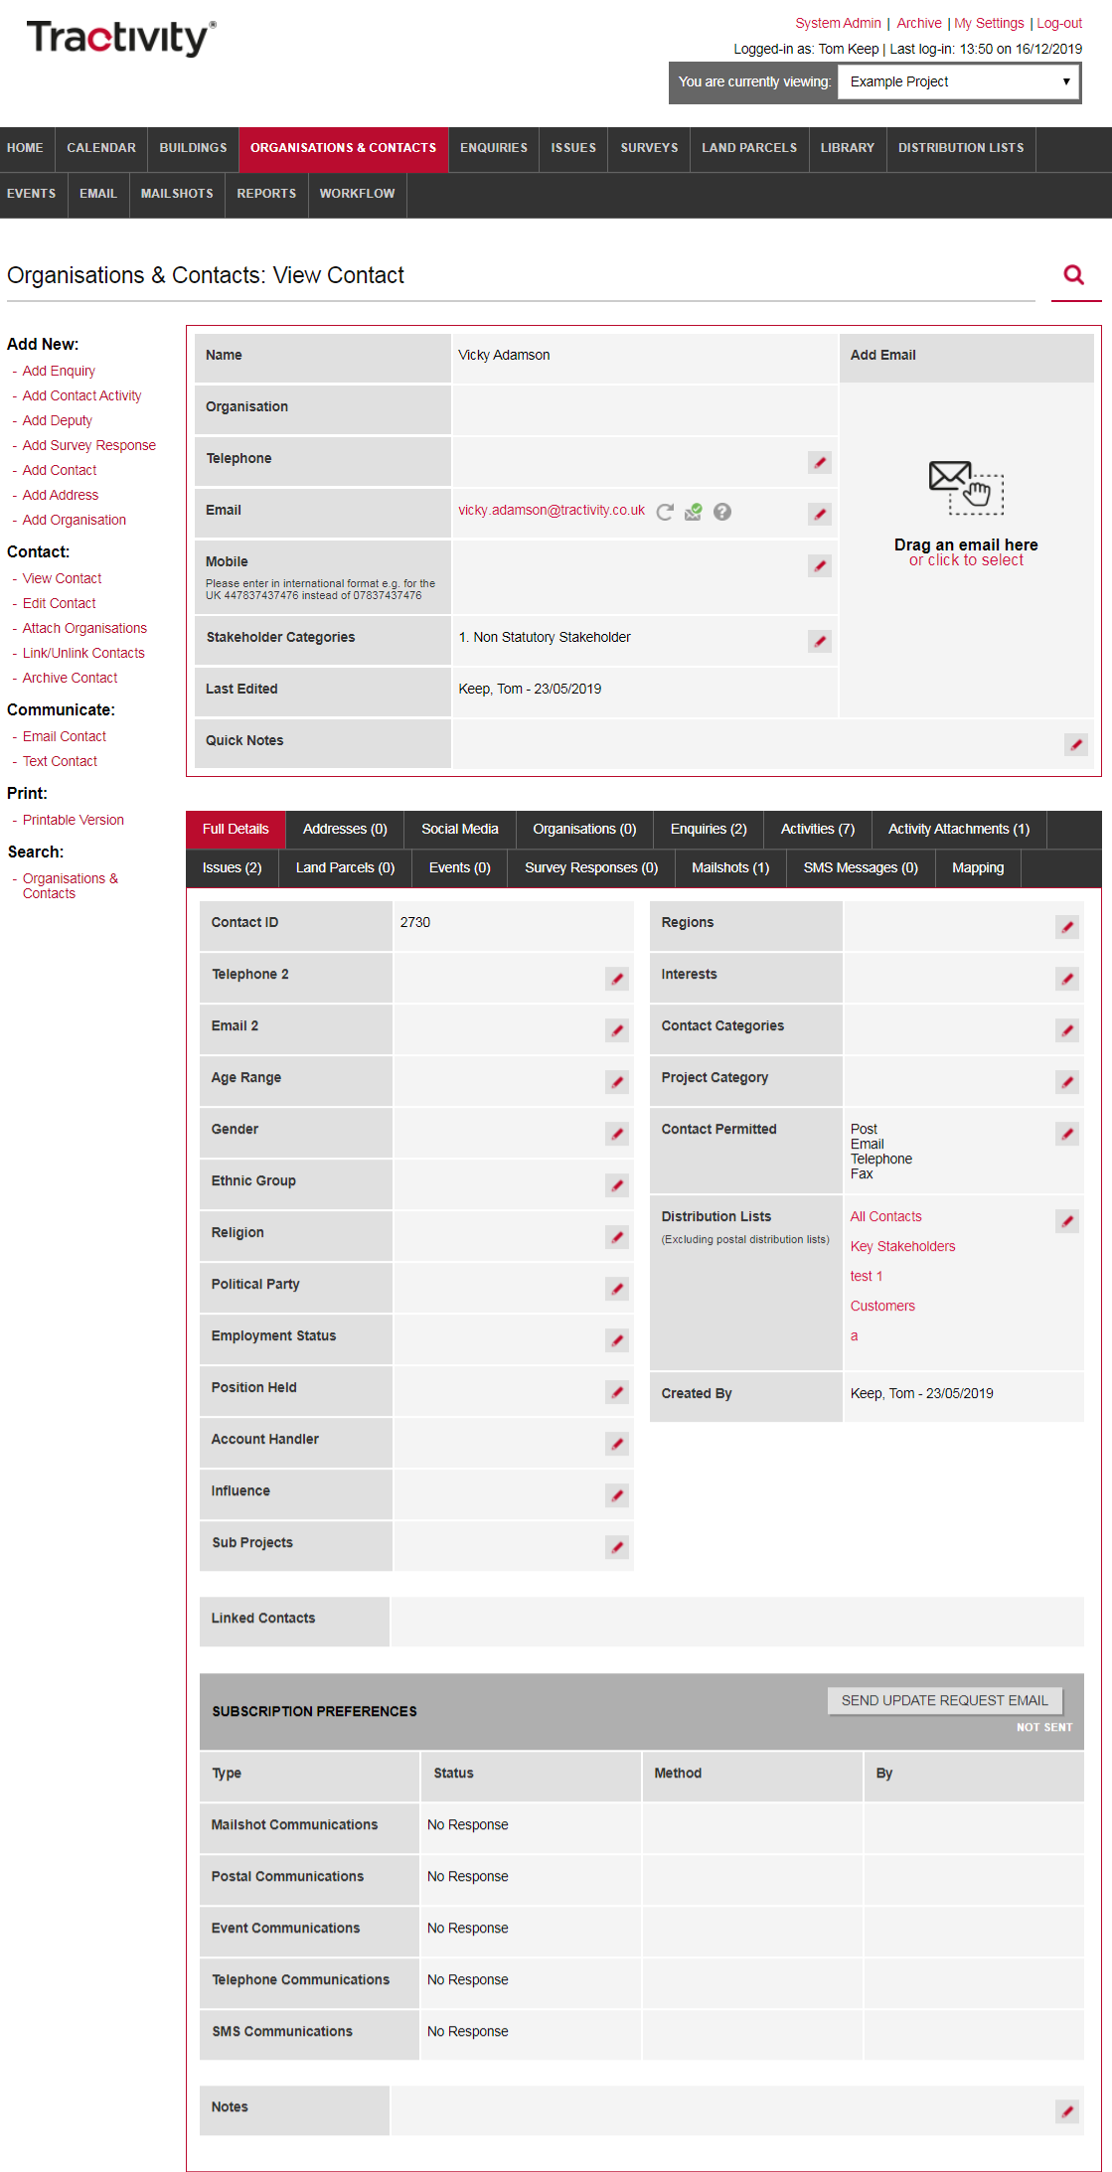
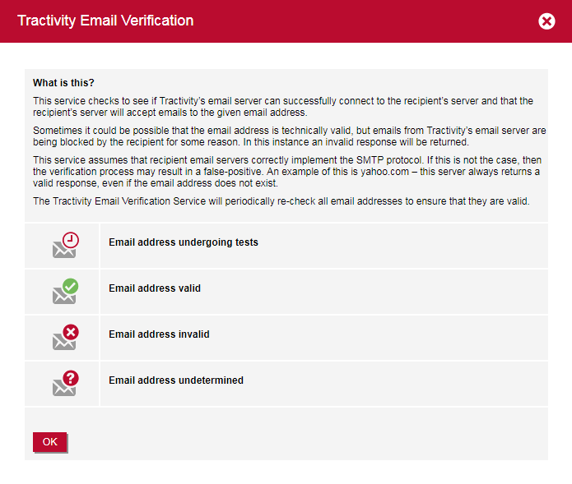
View Contact
From the View Contact Screen the Tractivity Email Validation tool, will continually check the email address is valid. Press the question mark symbol to view the Tractivity Email Verification Key.
1
1

Slide 19
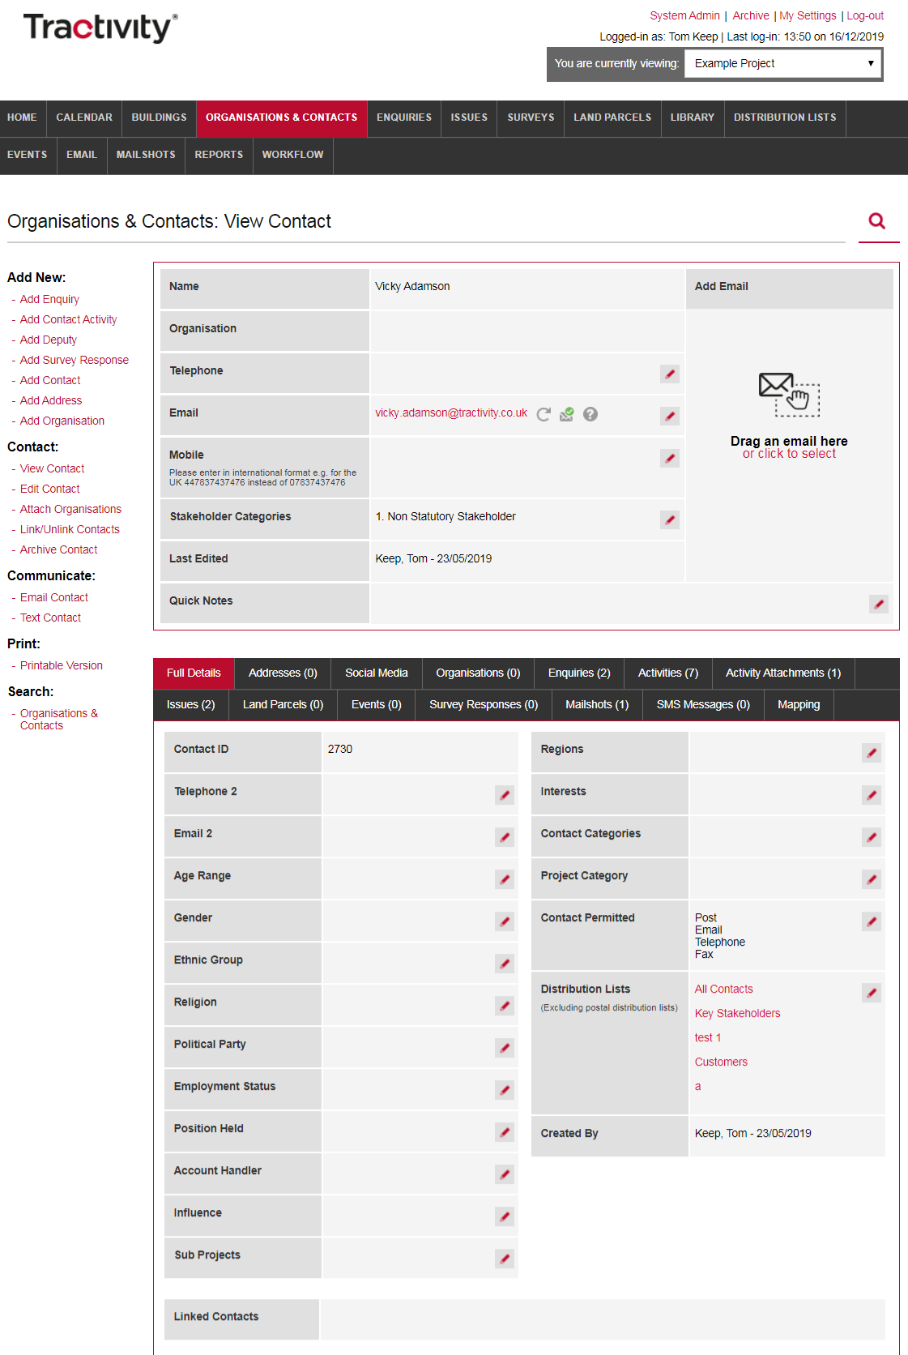
View Contact
View Contact Screen, is a useful area of the system:
View and Edit the information you have added, using the quick edit button.
Half-way navigation bar, will start to build and hold any information you add that relates to your contact, including enquiries, activities & issues.
1
2

Slide 20
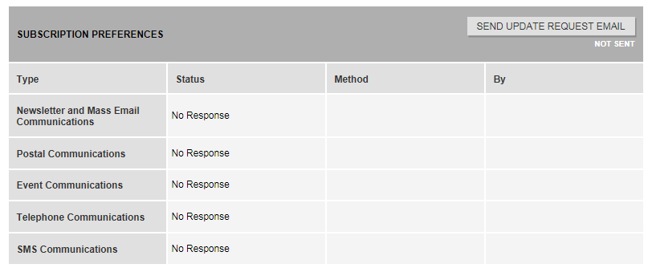
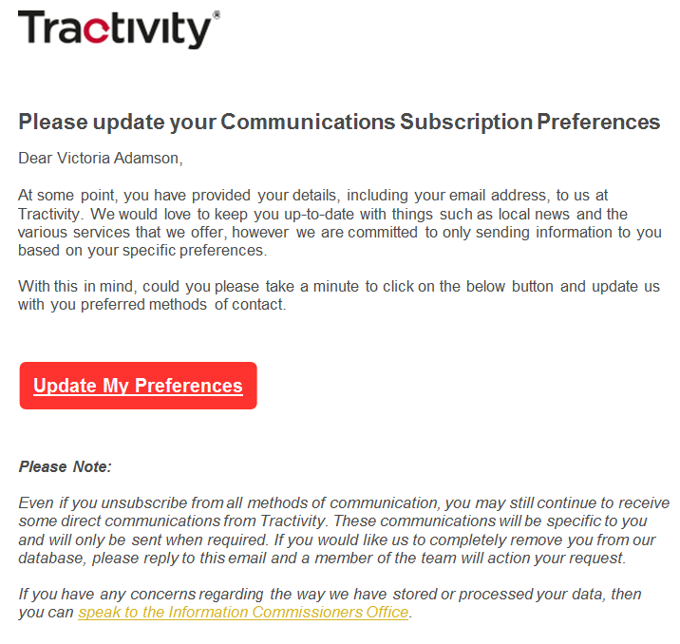
Send GDPR Subscription Preference from Tractivity
Send Update Request Email to obtain your company or contacts subscriptions preferences via an automated email.
SEND UPDATE REQUEST EMAIL button will only appear if a Valid Email address is added and Email Contact Permitted is selected.
Email Template is branded to meet your Organisations Brand Guidelines and agreed text.
Subscription Preferences Email- includes a button that enables Organisations and Contacts to update their preferences.
Subscription Preferences are automatically updated inside Tractivity.
1
2
3

Slide 21

Vicky Adamson
Client Relationship Manager
Systems House, Deepdale Business Park,
Bakewell, Derbyshire, DE45 1GT
www.tractivity.co.uk

