Slide 1

Email Module

Slide 2
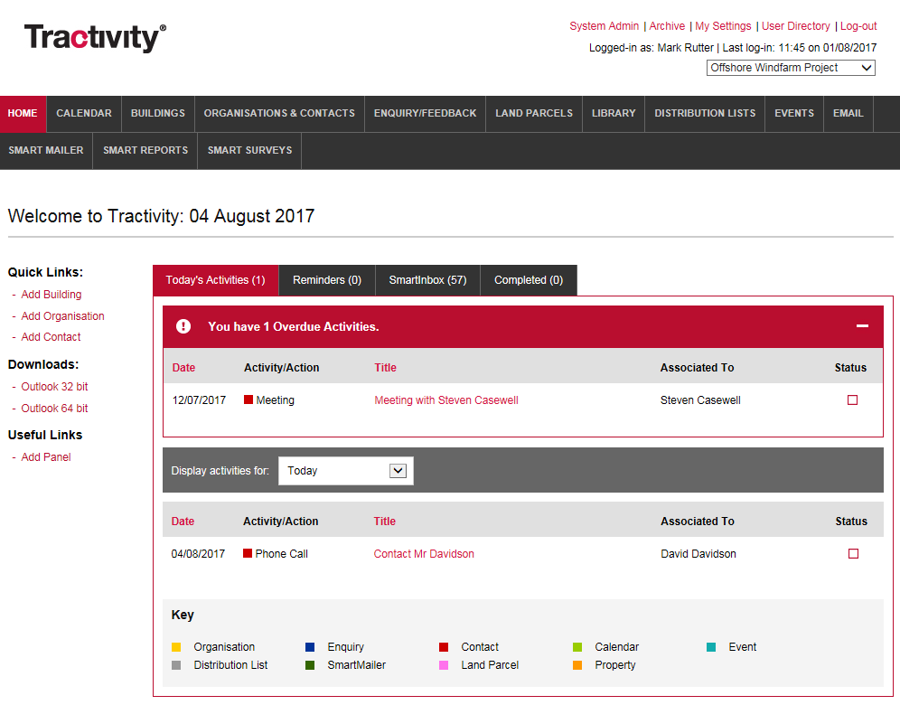
Email Module
Email module appears on the black navigation bar.
You can access the email module from most sections within your Tractivity system such as;
Contact & Organisation
Enquiry
Distribution Lists Screen
Activity
SmartInbox
1

Slide 3
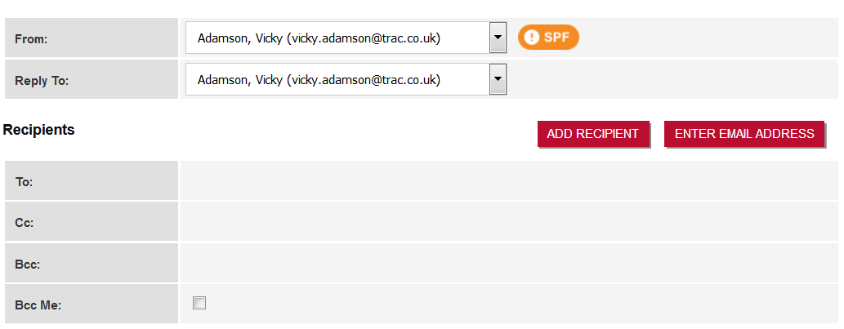
What Is a SPF record?
Email page is broken down into 4 sections. Firstly Tractivity checks to see if a valid SPF record is setup.
If an amber warning appears as shown here, you don’t have an SPF record setup. Don’t worry, this can be easily done through your IT team.
To setup a SPF Record please forward the below text to your IT team;
We are requesting that you ask your IT team to add a text-based SPF record to our email server, spf.tractivity.co.uk. An SPF record is essentially a rule that permits for our server to send emails on your behalf. This will mean that any SPAM checking software that runs an SPF lookup on receipt of an email will return a positive result.
If you are unable to setup an SPF or while this in progress, don’t worry, you can still send emails from Tractivity, however these will be sent from mailings@tracmail.co.uk on behalf of Vicky Adamson Vicky.adamson@trac.co.uk
1

Slide 4
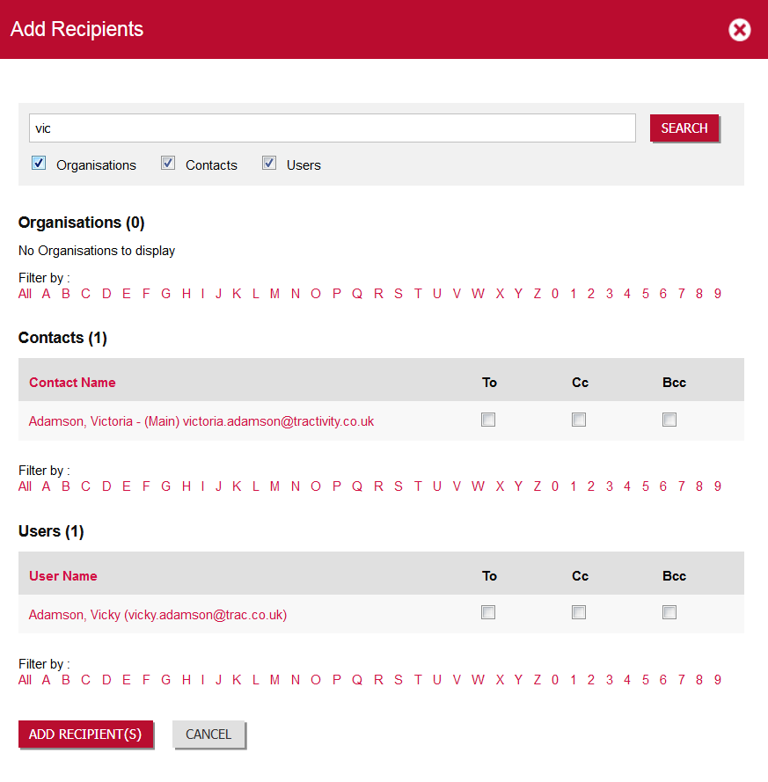
Add Recipients
Search for an Organisation, Contact or User. Add multiple recipients to one email.
When selecting to add each recipient, select one of the following; To, CC or Bcc.
To add Recipient(s) repeat the three steps as many times as you wish.
1
2
3

Slide 5
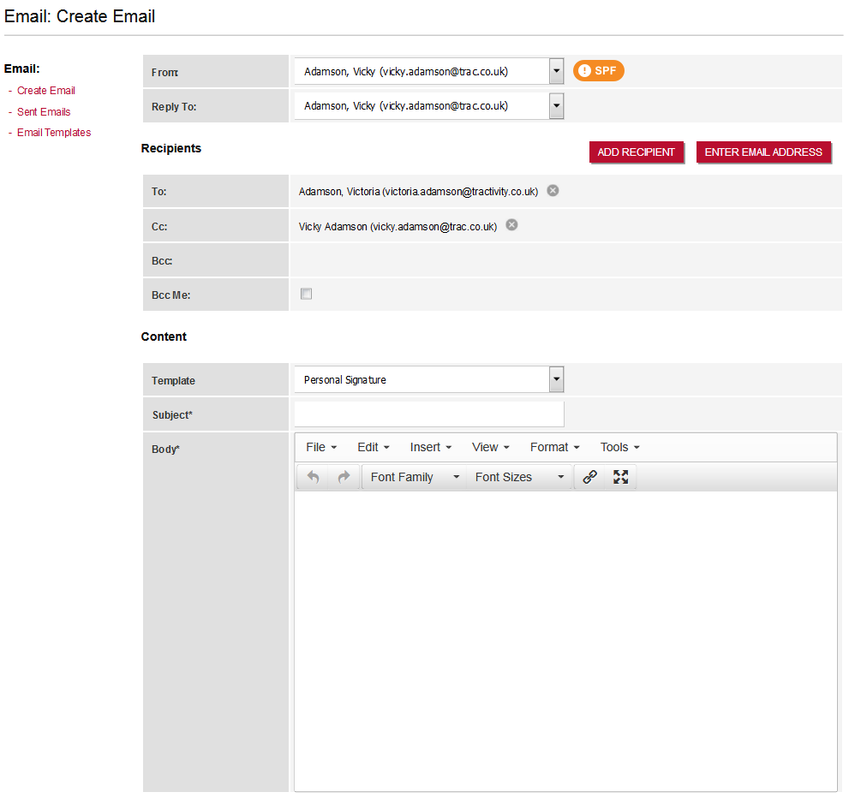
Bcc Emails to Yourself
Bcc (Blind Carbon copy) yourself into your email.
Email Templates and Personal Signatures.
A Personal Signature, will automatically be added to the body of your text. To setup your Personal Signature, use the My Settings, in the top right-hand corner.
Email Templates, you can create prewritten emails using the left hand menu link. Once created add them to the body of your text using the template drop-down menu.
2
1
2

Slide 6
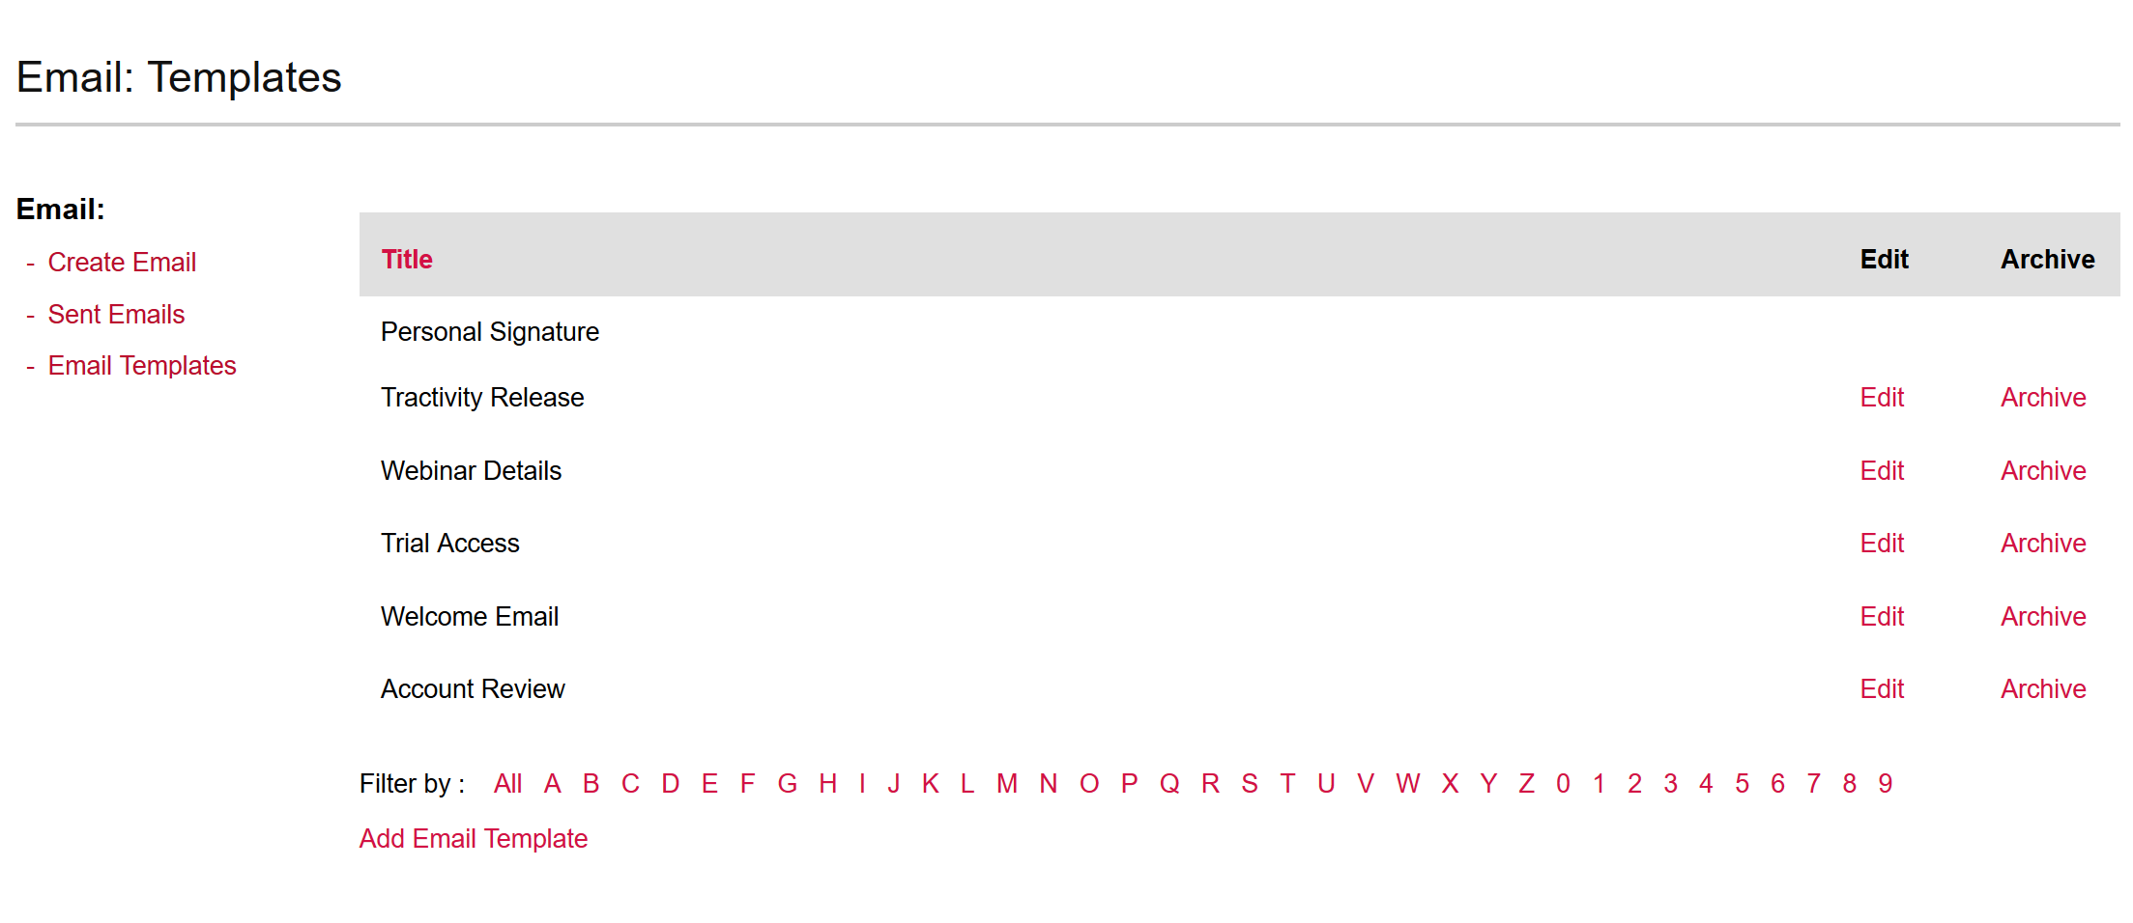
Creating Email Templates
To create an email template please follow the below steps;
Select Email Templates from the left-hand menu. (This will provide you with a current list of templates).
Add Email Template
Enter a Title and the Email Text and click OK to save and make available for all users to select moving forwards.
1
2

Slide 7
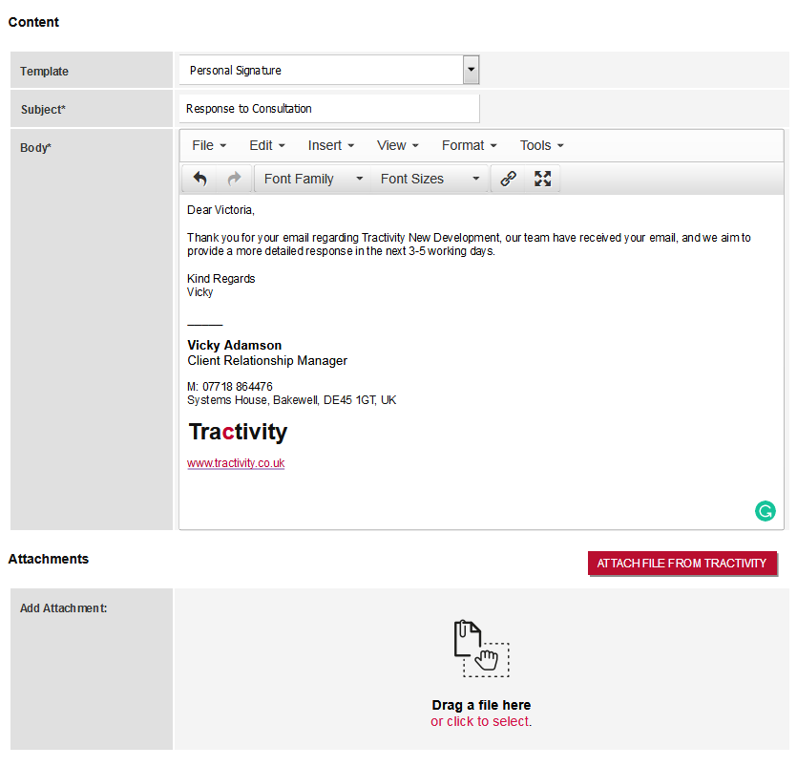
Adding Attachments to your Emails
All types of Attachments can be added into Tractivity and be sent through our Email facility.
To do so, you can either;
Locate the file from your computer and drag and drop the file in the Drag a file here section
OR
Simply click the click to select link which in turn will allow you to browse your computer and Add the file(s) to your email.
1

Slide 8
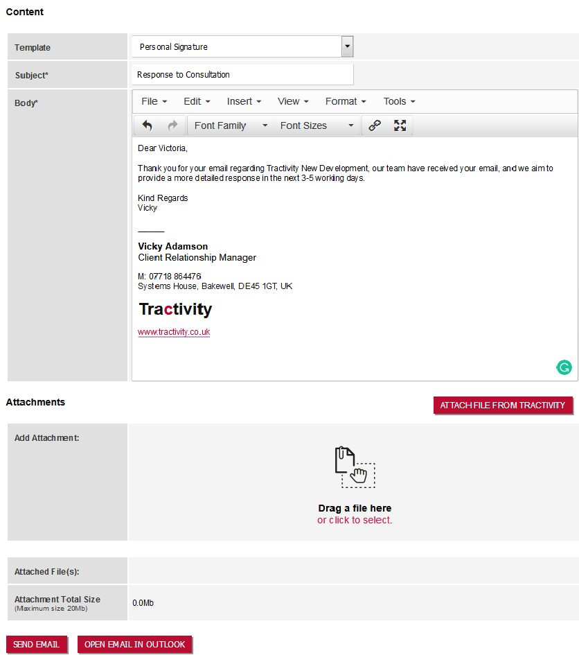
Sending Email Through Tractivity or MS Outlook
Email can either be sent through Tractivity or your Outlook account.
Send Email
Allows you to send your email to all named recipients and an activity will be automatically attached to all listed contact(s) and/or organisation(s) held within Tractivity.
2. Open Email in Outlook
Allows you to open your email inside your Outlook account, however an activity will not be automatically created inside Tractivity.
Please Note – If emails need to saved against an enquiry, please view the next slide.
1
2

Slide 9
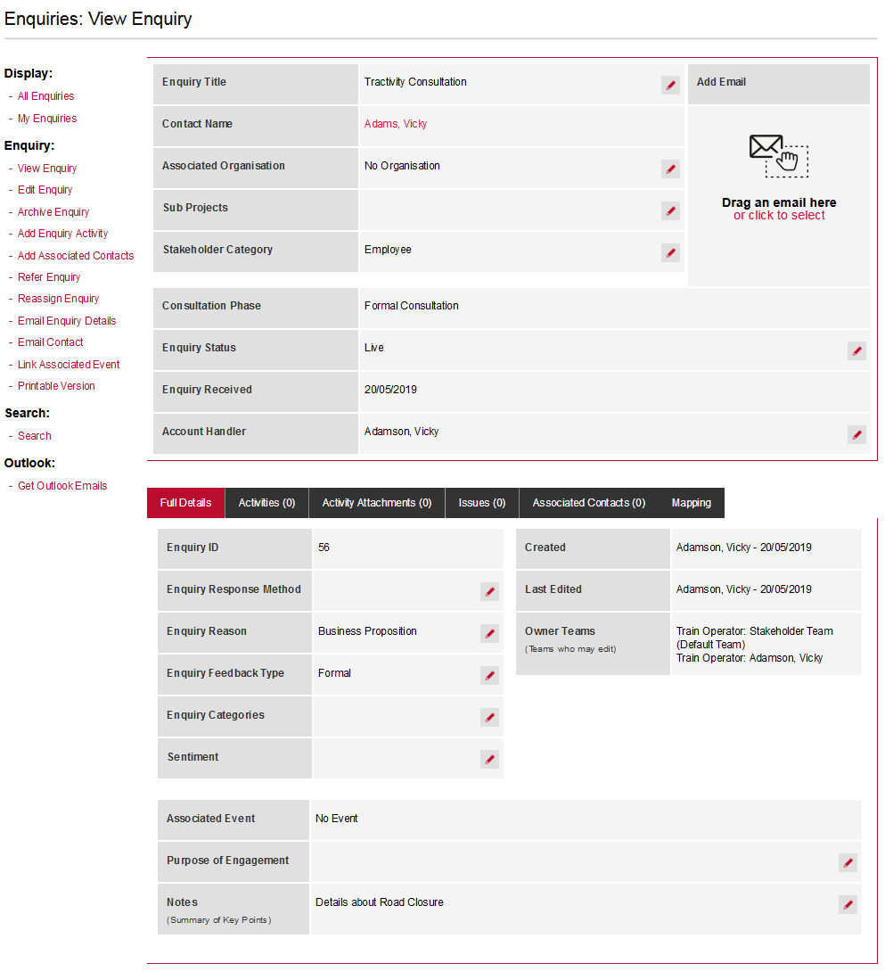
Send Emails from View Enquiry Screen
When all communications need to be saved against an enquiry, follow the below steps;
Find or Create an Enquiry.
Inside the, View Enquiry screen, on the left-hand menu, select Email Contact.
1
2

Slide 10
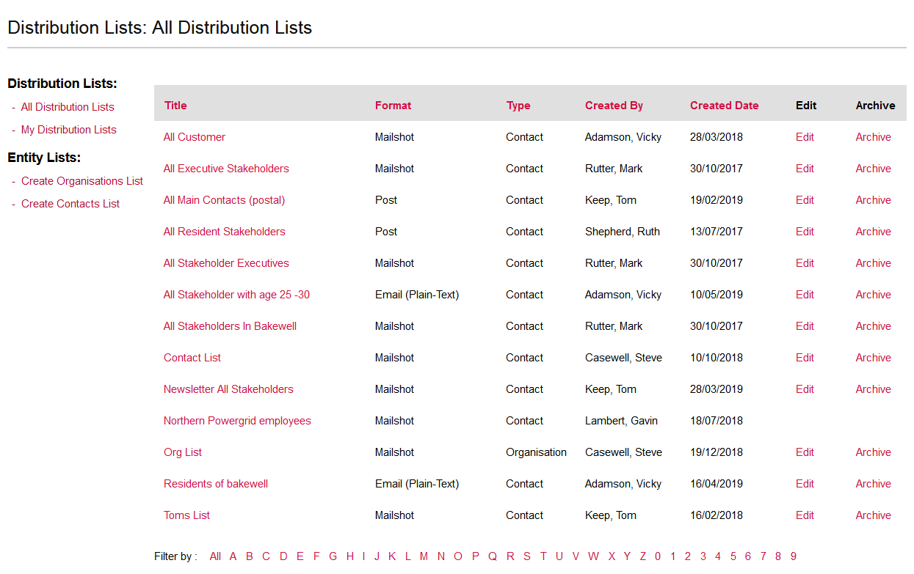
Emailing a Distribution List
1
To email an a distribution list you need the following;
Inside the Distribution Lists Module, the format of your distribution lists needs to Email (Plain-Text).

Slide 11
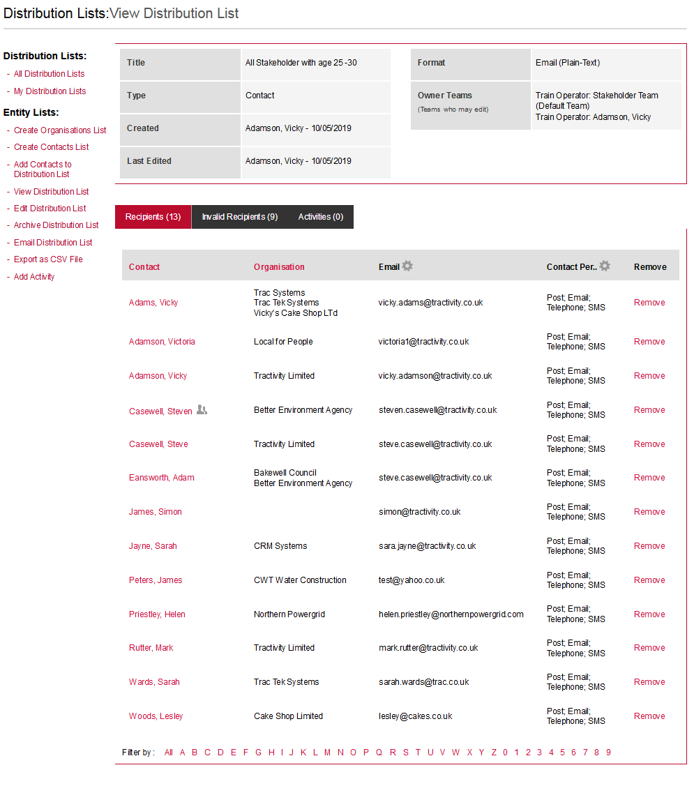
Emailing from a Distribution List
In some cases you may wish to send an email to a specific group of stakeholders;
Create an new Distribution List
OR
Use an Existing Distribution list. Remember to search to ensure no new contacts have not been missed off your distribution list.
2. Email Distribution List, to create your email via the Email module. All activities will be automatically created against each contact or organisation inside Tractivity.
If you require to be record more Enquiry information against an email, such as sub project please view the next slide.
1
1
2

Slide 12
1
Create an Enquiry with multiple contacts associated.
If you require to record more Enquiry information against an email, such as sub project, follow the below steps;
1. Create Enquiry against one of the contacts from the distribution list.
2. From the View Enquiry Screen on the Left-hand menu select, Add Associated contacts.
3. Use the search boxes to find your distribution list and add all the contacts.
4. From the View Enquiry Screen on the Left-hand menu, select Add Associated contacts.
2
3

Slide 13

Vicky Adamson
Client Relationship Manager
Systems House, Deepdale Business Park,
Bakewell, Derbyshire, DE45 1GT
www.tractivity.co.uk

